Slide 1


DATA STRUCTURES USING C Lecture 2
Prof. P. S. Avadhani
M. Tech., PhD., F.I.E,FCSI, FAPAS.
Visiting Professor, Central University of Odisha
Former Director, IIIT, Agartala
Former Principal, AU College of Engg,
Andhra University, Visakhapatnam

Slide 2
Array Definition
A linear array is a list of finite number of homogeneous (same data-type) of data elements such that
The elements of the array are referenced respectively by an index set consisting of consecutive numbers.
The elements of the array are stored respectively in successive memory locations.

Slide 3
Arrays
ONE-DIMENSIONAL ARRAY (OR LINEAR ARRAY)
a[] =
a is a one-dimensional array with a[0] = 17, a[1] = 3, a[2] = 12 ……..
MULTI-DIMENSIONAL ARRAY
b[][] =
b is a two-dimensional array with b[0][0] = 12, b[0][1]= 31, b[0][2] = 7, b[1][0] = 16, b[1][1] = 59, b[1][2] = 18, b[2][0] = 21, b[2][1] = 27, b[2][2] = 99
17 | 3 | 12 | 16 | 19 | 37 | 15 | 61 | 63 | 6
12 | 31 | 7
16 | 59 | 18
21 | 27 | 99

Slide 4
Array Definition Contd…
The number of elements of the array is called the length or size of the array
If UB is the upper bound (or the largest index) and LB is the lower bound ( or the smallest index) then
Length = UB-LB+1
In the above array, if we count from 0 then the last element is at 9. So, LB = 0, UB = 9 and hence
Length = 9-0+1 = 10.
If we start counting from, let us say 10, then UB = 19 and LB = 10 and the length is same.
17 | 3 | 12 | 16 | 19 | 37 | 15 | 61 | 63 | 6

Slide 5
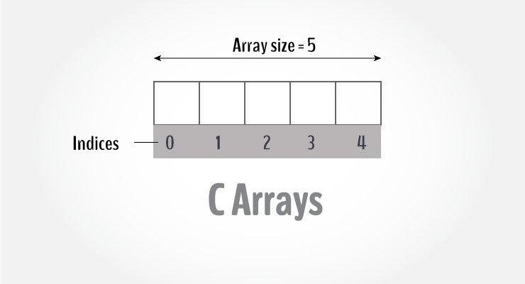
C-Arrays

Slide 6
Declaring an array in C
dataType arrayName[arraySize];
For example, float mark[5];
Here, we declared an array, mark, of floating-point type and its size is 5. Meaning, it can hold 5 floating-point values.
It's important to note that the size and type of an array cannot be changed once it is declared.

Slide 7
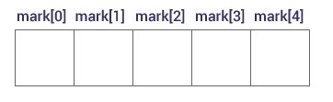
Accessing the elements of an Array
You can access elements of an array by indices.
Suppose you declared an array mark as below. The first element is mark[0], the second element is mark[1] and so on.

Slide 8
Some important points
Arrays have 0 as the first index, not 1. In this example, mark[0] is the first element.
If the size of an array is n, to access the last element, the n-1 index is used. In this example, mark[4]
Suppose the starting address of mark[0] is 2120d. Then, the address of the mark[1] will be 2124d.
Similarly, the address of mark[2] will be 2128d and so on.
This is because the size of a float is 4 bytes.

Slide 9
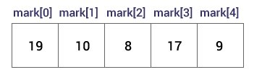
Initialization of an array
It is possible to initialize an array during declaration. For example,
int mark[5] = { 19, 10, 8,17,9};
You can also initialize an array like this.
int mark[ ] = { 19, 10, 8,17,9};
Here, we haven't specified the size. However, the compiler knows its size is 5 as we are initializing it with 5 elements.
If we later want to change a particular value ( say, 17 as 5 then we can write mark[3] = 5;

Slide 10
Input and Output Array Elements
Here's how you can take input from the user and store it in an array element.
//take input and store it in the third element
Scanf(“%d”, &mark[2]);
//take input and store it in the ith element
Scanf(“%d”, &mark[i-1]);
Here's how you can print an individual element of an array.
//print the first element of the array
printf(“%d”, &mark[0]);
//print the ith element of the array
printf(“%d”, &mark[i-1]);

Slide 11
Example 1: Array Input/Output
/ Program to take 5 values from the user and store them in an array
// Print the elements stored in the array
#include <stdio.h>
int main()
{
int values[5];
printf("Enter 5 integers: ");
// taking input and storing it in an array
for(int i = 0; i < 5; ++i)
{
scanf("%d", &values[i]);
}
printf("Displaying integers: ");
// printing elements of an array
for(int i = 0; i < 5; ++i)
{
printf("%d\n", values[i]);
}
return 0;
}

Slide 12
Output
Enter 5 integers: 1
-3
34
0
3
Displaying integers: 1
-3
34
0
3
Here, we have used a for loop to take 5 inputs from the user and store them in an array. Then, using another for loop, these elements are displayed on the screen.

Slide 13
Example 2: Calculating Average
// Program to find the average of n numbers using arrays
#include <stdio.h>
int main()
{
int marks[10], i, n, sum = 0, average;
printf("Enter number of elements: ");
scanf("%d", &n);
for(i=0; i<n; ++i) {
printf("Enter number%d: ",i+1);
scanf("%d", &marks[i]);
// adding integers entered by the user to the sum variable
sum += marks[i];
}
average = sum/n;
printf("Average = %d", average);
return 0;
}

Slide 14
Example 2: Output
Enter n: 5
Enter number1: 45
Enter number2: 35
Enter number3: 38
Enter number4: 31
Enter number5: 49
Average = 39
Here, we have computed the average of n numbers entered by the user.

Slide 15
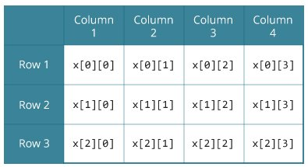
Multi-dimensional Arrays
In C programming, you can create an array of arrays. These arrays are known as multidimensional arrays. For example,
float x[3][4];
Here, x is a two-dimensional array. The array can hold 12 elements. You can think of the array as a table with 3 rows and each row has 4 columns.
Similarly, you can declare a three-dimensional array. For example, float y[2][3][4];
Here, the array y can hold 24 elements.

Slide 16
Initializing a Multi-Dimensional Array
//Different ways to initialize two-dimensional array
int c[2][3] = {{1, 3, 0}, {-1, 5, 9}};
int c[][3] = {{1, 3, 0}, {-1, 5, 9}};
int c[2][3] = {1, 3, 0, -1, 5, 9};
Three-dimensional array can be initialized in a similar way.
int test[2][3][4] = {
{
{3, 4, 2, 3},
{0, -3, 9, 11},
{23, 12, 23, 2}
},
{
{13, 4, 56, 3},
{5, 9, 3, 5},
{3, 1, 4, 9}
}
};

Slide 17
Example 3: Two-dimensional array to store and print values
// C program to store temperature of two cities of a week and display it.
#include <stdio.h>
const int CITY = 2;
const int WEEK = 7;
int main()
{
int temperature[CITY][WEEK];
// Using nested loop to store values in a 2d array
for (int i = 0; i < CITY; ++i) {
for (int j = 0; j < WEEK; ++j) {
printf("City %d, Day %d: ", i + 1, j + 1);
scanf("%d", &temperature[i][j]);
}
}
printf("\nDisplaying values: \n\n");
// Using nested loop to display vlues of a 2d array
for (int i = 0; i < CITY; ++i) {
for (int j = 0; j < WEEK; ++j) {
printf("City %d, Day %d = %d\n", i + 1, j + 1, temperature[i][j]);
}
}
return 0;
}

Slide 18
Example 3: Output
City 1, Day 1: 33
City 1, Day 2: 34
City 1, Day 3: 35
City 1, Day 4: 33
City 1, Day 5: 32
City 1, Day 6: 31
City 1, Day 7: 30
City 2, Day 1: 23
City 2, Day 2: 22
City 2, Day 3: 21
City 2, Day 4: 24
City 2, Day 5: 22
City 2, Day 6: 25
City 2, Day 7: 26

Slide 19
Output –contd..
Displaying values:
City 1, Day 1 = 33
City 1, Day 2 = 34
City 1, Day 3 = 35
City 1, Day 4 = 33
City 1, Day 5 = 32
City 1, Day 6 = 31
City 1, Day 7 = 30
City 2, Day 1 = 23
City 2, Day 2 = 22
City 2, Day 3 = 21
City 2, Day 4 = 24
City 2, Day 5 = 22
City 2, Day 6 = 25
City 2, Day 7 = 26

Slide 20
Assignment 1
1) Discuss, in detail, about the definition and concept of Data Structures
2) Explain about the Linear and Multi-Dimensional Arrays with examples.
3) Writ a program in C to find the sum of all the diagonal elements of a square matrix
4) Write a C Program to find the product of two matrices of orders m x n and n x p.
Date of submission: 20th Sept 2021

Slide 21
Questions?

Slide 22
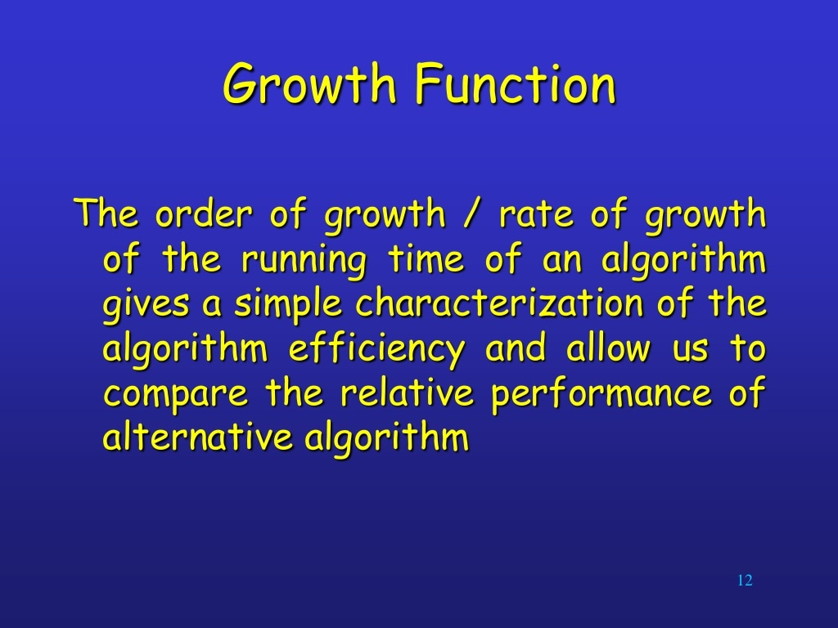

Slide 23
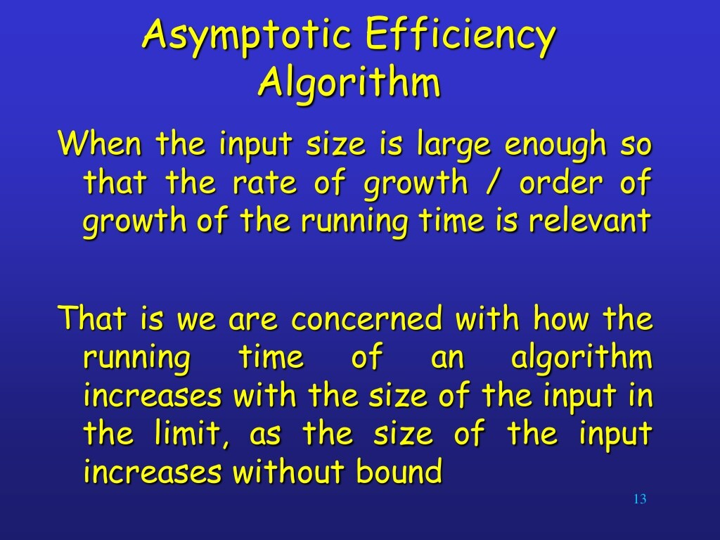

Slide 24


Slide 25


Slide 26


Slide 27


Slide 28
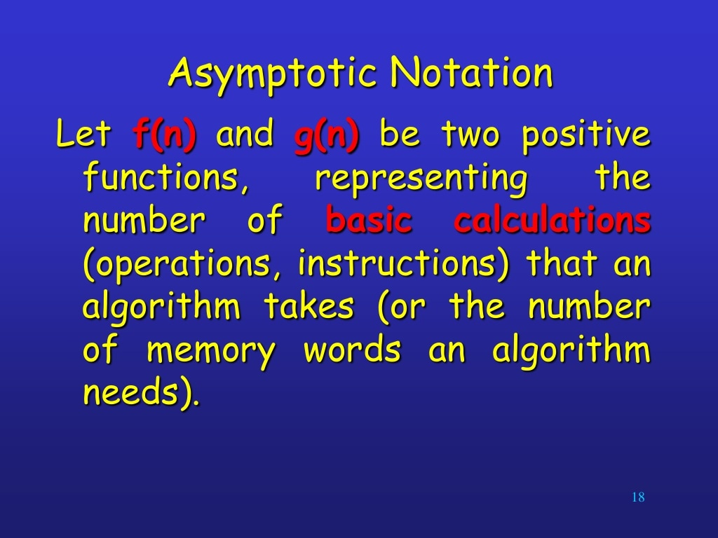

Slide 29


Slide 30
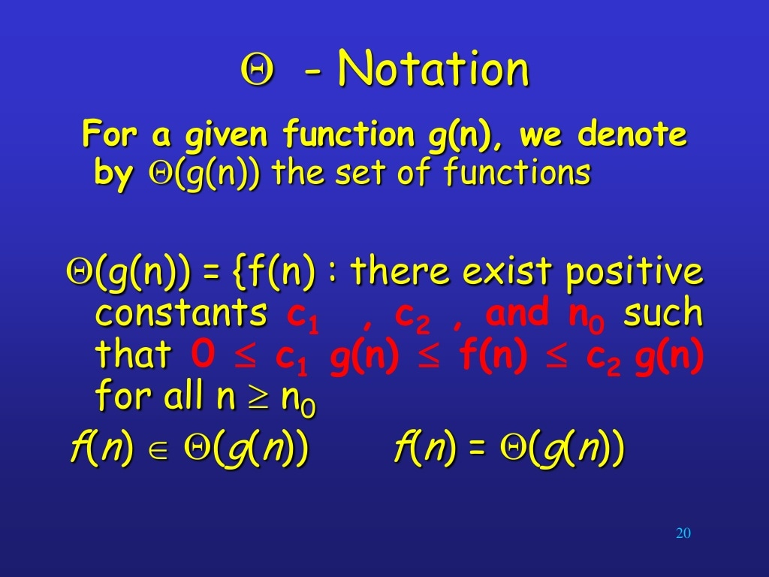

Slide 31


Slide 32
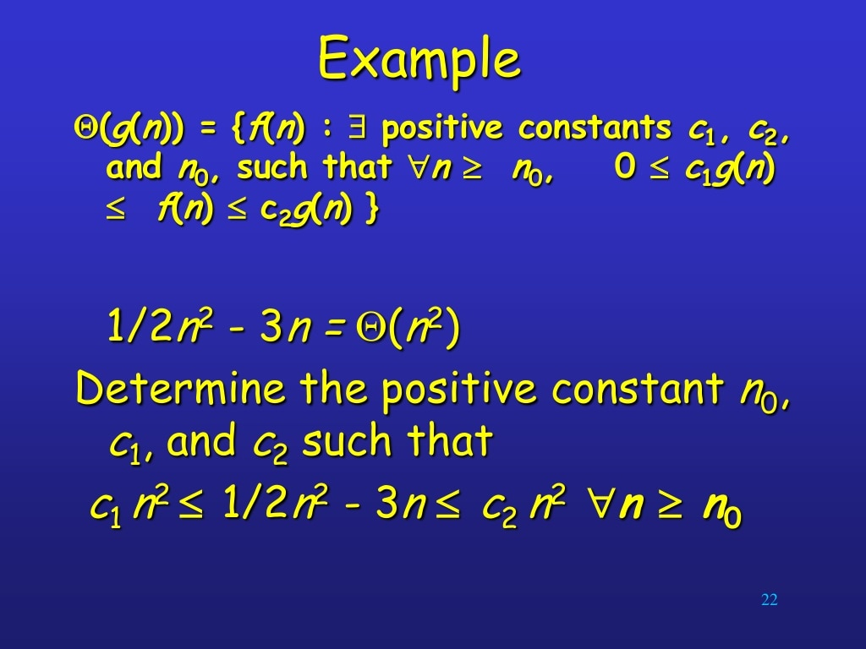

Slide 33
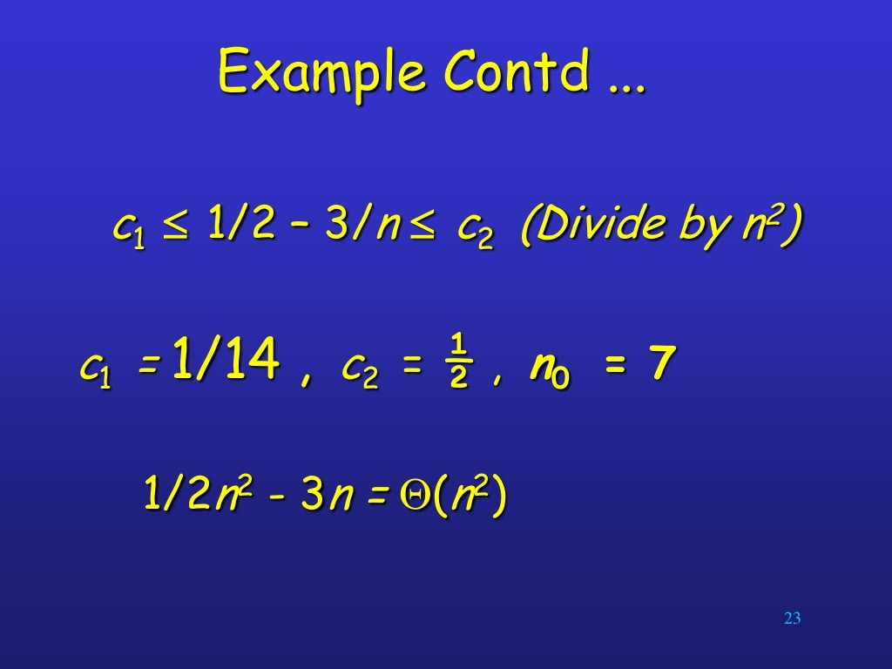

Slide 34
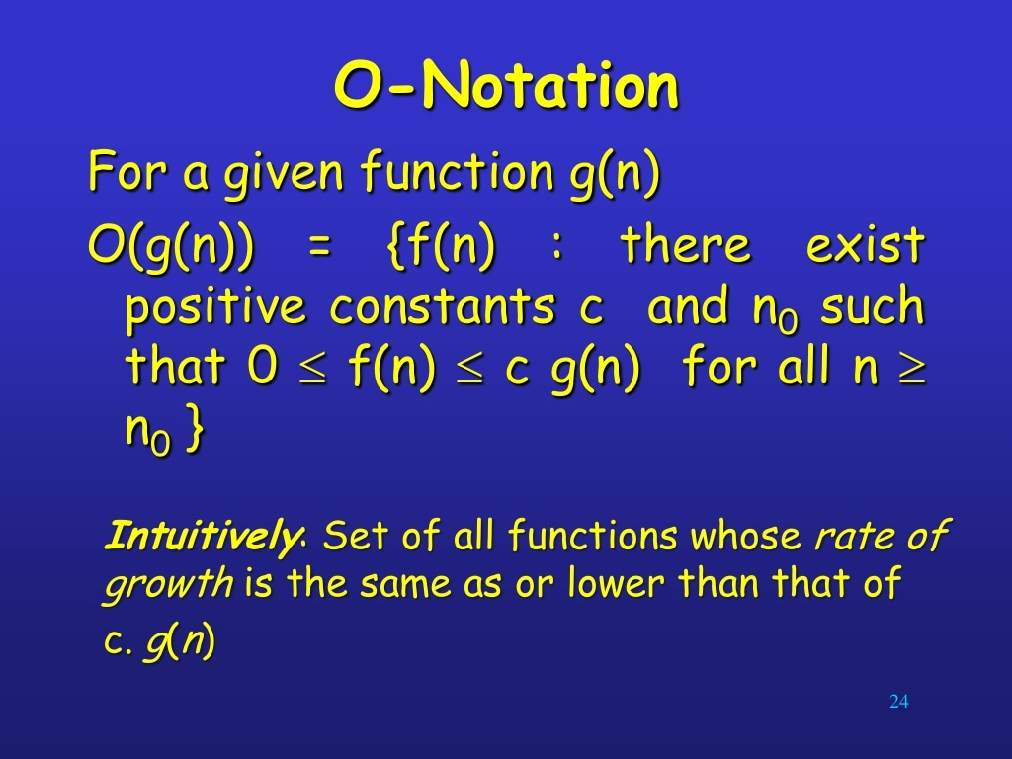

Slide 35


Slide 36
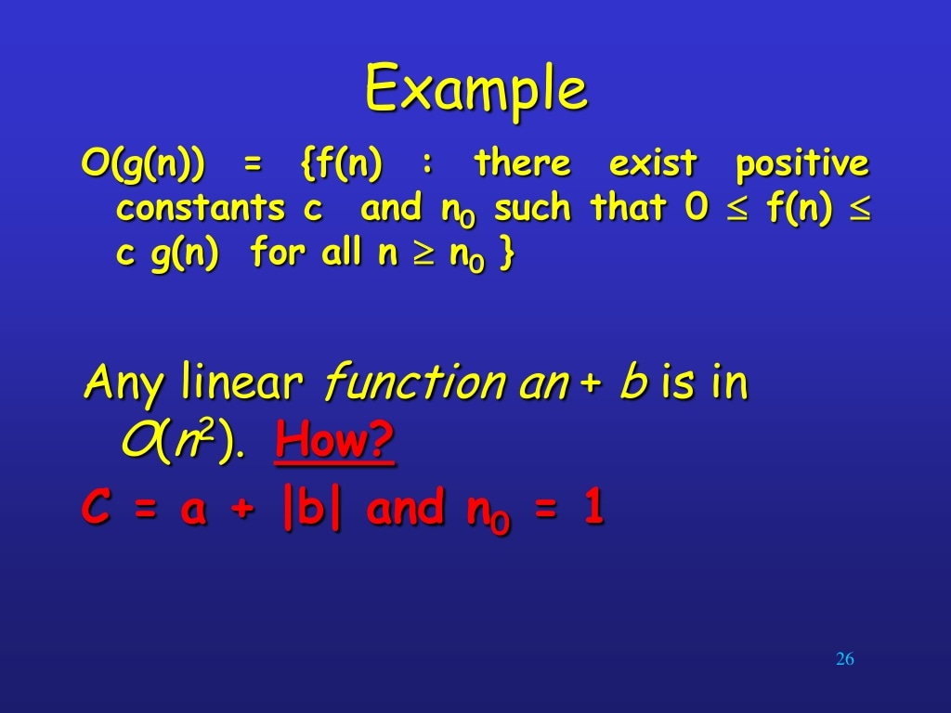

Slide 37


Slide 38


Slide 39
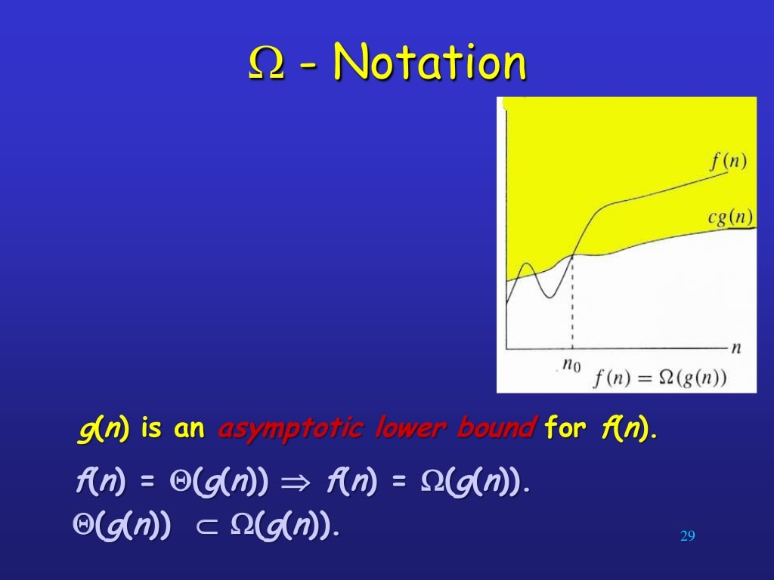

Slide 40
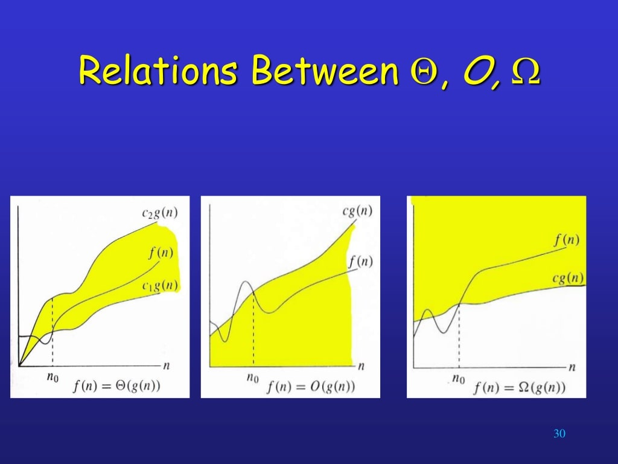

Slide 41
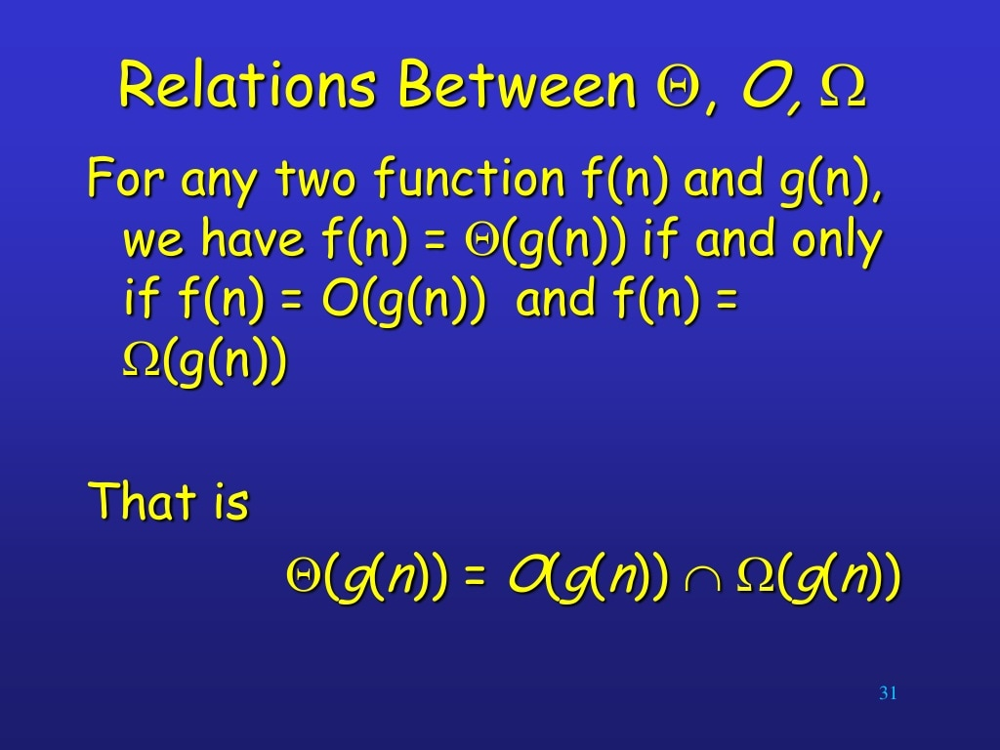

Slide 42
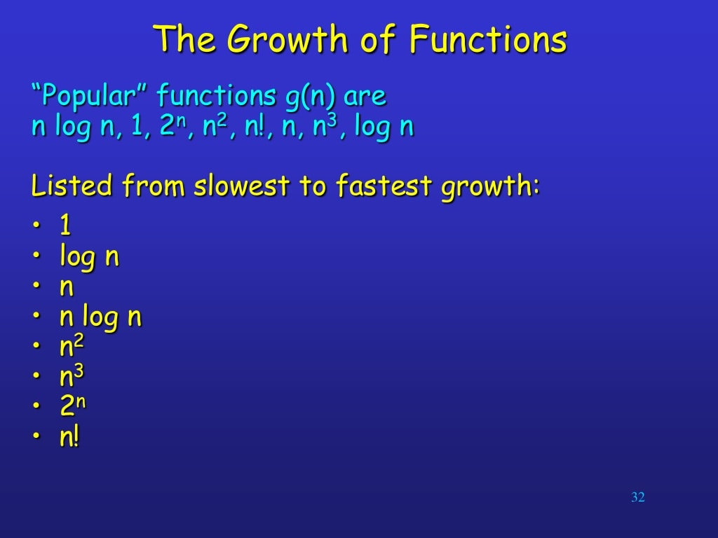

Slide 43
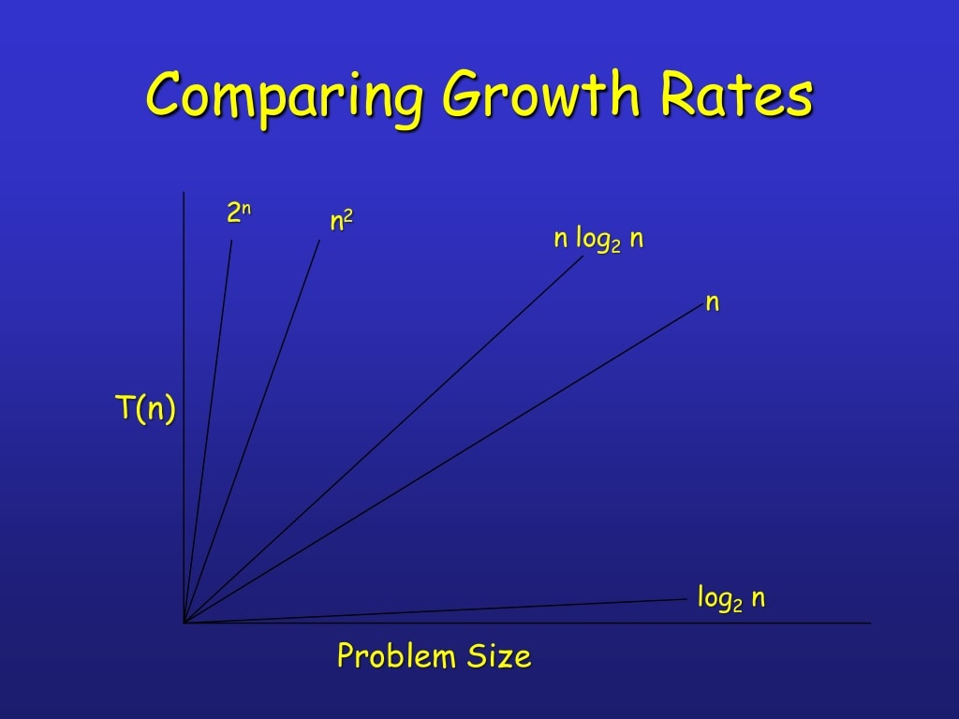

Slide 44
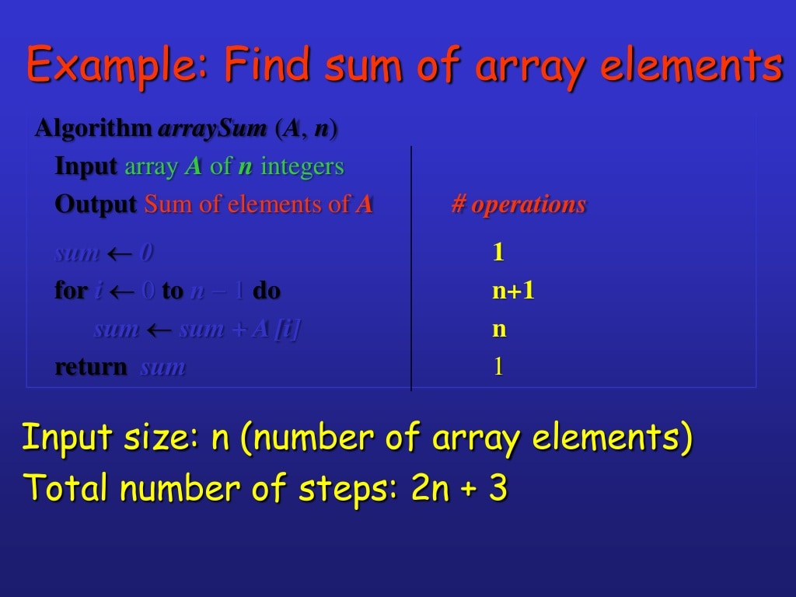

Slide 45
Questions?

Slide 46
Thank You

